Slide 1
Public Input for Gratiot County's Master Plan Update
January 2024
Date Created: Friday, September 22, 2023
Complete Responses: 314

Slide 2
Q1: How long have you lived in Gratiot County?
Answered: 314 Skipped: 0

Slide 3
Q1: How long have you lived in Gratiot County?
Answered: 314 Skipped: 0
ANSWER CHOICES | RESPONSES
Less than one year | 3.82% | 12
Not Applicable | 5.73% | 18
6-10 years | 10.51% | 33
1-5 years | 10.83% | 34
11-25 years | 20.70% | 65
Over 25 years | 48.41% | 152
TOTAL |  | 314

Slide 4
Q2: Where do you live within Gratiot County?
Answered: 314 Skipped: 0

Slide 5
Q3: Is your place of employment located within Gratiot County?
Answered: 314 Skipped: 0

Slide 6
Q4: If you do work in Gratiot County, what industry do you work in?
Answered: 314 Skipped: 0

Slide 7
Q5: What do you like about living in Gratiot County? Please select your top 3 responses.
Answered: 314 Skipped: 0

Slide 8
Q5: What do you like about living in Gratiot County? Please select your top 3 responses.
Answered: 314 Skipped: 0
ANSWER CHOICES | RESPONSES
Low tax rate | 8.92% | 28
Affordable housing | 20.06% | 63
Small town character | 69.75% | 219
Family ties | 44.27% | 139
Low crime rate | 41.72% | 131
Convenience to work | 35.99% | 113
Access to highways | 14.33% | 45
Open spaces | 21.66% | 68
School system | 18.15% | 57
Historic resources | 2.87% | 9
Recreation opportunities | 6.69% | 21
Community activities | 15.29% | 48
Employment opportunities | 6.37% | 20
Convenience to services | 12.42% | 39
Available land for farming | 5.73% | 18
Other (please specify) | 5.41% | 17
TOTAL |  | 1035

Slide 9
Q6: What do you find undesirable about living in Gratiot County? Please select your top 3 responses.
Answered: 314 Skipped: 0

Slide 10
Q6: What do you find undesirable about living in Gratiot County? Please select your top 3 responses.
Answered: 314 Skipped: 0
ANSWER CHOICES | RESPONSES
High tax rate | 24.84% | 78
Lack of retail shopping opportunities | 63.38% | 199
Lack of a community-gathering place | 30.57% | 96
School system | 17.83% | 56
Lack of affordable housing | 32.48% | 102
Municipal services | 10.51% | 33
Lack of recreation opportunities | 51.27% | 161
Excessive traffic | 3.18% | 10
Lack of employment opportunities | 41.08% | 129
Excessive development | 3.18% | 10
Loss of small-town character | 7.96% | 25
Other (please specify) | 24.84% | 78
TOTAL |  | 977

Slide 11
Q7: The Master Plan Team is examining the following topics. Please indicate their importance to you.
Answered: 314 Skipped: 0

Slide 12
 | VERY IMPORTANT | FAIRLY IMPORTANT | NEUTRAL | FAIRLY UNIMPORTANT | VERY UNIMPORTANT | TOTAL | WEIGHTED AVERAGE
Road quality | 54.78% 172 | 37.26% 117 | 6.69% 21 | 0.96% 3 | 0.32% 1 | 314 | 1.55
Employment opportunities | 53.50% 168 | 31.21% 98 | 12.42% 39 | 0.64% 2 | 2.23% 7 | 314 | 1.67
Overall appearance | 37.58% 118 | 49.04% 154 | 12.10% 38 | 0.96% 3 | 0.32% 1 | 314 | 1.77
Recreational resources | 43.31% 136 | 39.81% 125 | 12.74% 40 | 3.50% 11 | 0.64% 2 | 314 | 1.78
Public services | 42.68% 134 | 30.57% 96 | 22.61% 71 | 3.50% 11 | 0.64% 2 | 314 | 1.89
Housing choices | 40.45% 127 | 33.76% 106 | 22.61% 71 | 1.59% 5 | 1.59% 5 | 314 | 1.90
Shopping opportunities | 35.03% 110 | 41.08% 129 | 16.24% 51 | 6.37% 20 | 1.27% 4 | 314 | 1.98
Community and cultural events | 29.62% 93 | 44.90% 141 | 21.02% 66 | 3.50% 11 | 0.96% 3 | 314 | 2.01
Non-motorized transportation facilities (e.g. bicycle lanes, paved paths) | 26.43% 83 | 33.44% 105 | 25.80% 81 | 9.55% 30 | 4.78% 15 | 314 | 2.33
Public transportation | 25.48% 80 | 28.66% 90 | 27.71% 87 | 10.51% 33 | 7.64% 24 | 314 | 2.46

Slide 13
Q8: What types of recreational opportunities would you like to see more of in Gratiot County? (You can check more than one.)
Answered: 314 Skipped: 0

Slide 14
Q9: What types of housing do you think Gratiot County needs more of? (You can check more than one.)
Answered: 314 Skipped: 0

Slide 15
Q10: How satisfied are you with the County's access to internet services?
Answered: 314 Skipped: 0

Slide 16
Q11: Should the County continue to support alternative energy development to diversify power generation?
Answered: 314 Skipped: 0

Slide 17
Q12: If yes, what type?
Answered: 295 Skipped: 19

Slide 18
Q13: Where do you think alternative energy facilities should be located? (You can check more than one.)
Answered: 314 Skipped: 0

Slide 19
Q14: What do you see as the benefit(s) of encouraging business/industrial development in the County? (You can check more than one.)
Answered: 314 Skipped: 0

Slide 20
Q15: What do you see as the disadvantage(s) of encouraging economic development? (You can check more than one.)
Answered: 314 Skipped: 0

Slide 21
Q16: Of the options below, what are the challenges facing Gratiot County as it works to improve jobs and economic growth? (Please rank from least challenging to most challenging)
Answered: 313 Skipped: 1

Slide 22
 | NOT CHALLENGING | POSES A LOW-TO-MODERATE CHALLENGE | POSES A MODERATELY-HIGH CHALLENGE | VERY CHALLENGING | TOTAL | WEIGHTED AVERAGE
Keeping young, skilled workers | 2.57% 8 | 9.32% 29 | 38.26% 119 | 49.84% 155 | 311 | 3.35
Availability of diverse housing options | 3.24% 10 | 20.06% 62 | 39.81% 123 | 36.89% 114 | 309 | 3.10
Availability of jobs | 4.52% 14 | 26.13% 81 | 47.42% 147 | 21.94% 68 | 310 | 2.87
Access to capital and resources for small businesses | 5.98% 18 | 38.21% 115 | 39.20% 118 | 16.61% 50 | 301 | 2.66
Quality of life amenities | 9.35% 29 | 37.42% 116 | 37.74% 117 | 15.48% 48 | 310 | 2.59
Inadequate transportation infrastructure | 14.52% 45 | 39.68% 123 | 26.13% 81 | 19.68% 61 | 310 | 2.51
Inadequate public services and infrastructure | 9.42% 29 | 45.13% 139 | 32.47% 100 | 12.99% 40 | 308 | 2.49
Local government leadership | 15.69% 48 | 41.50% 127 | 26.80% 82 | 16.01% 49 | 306 | 2.43
Access to quality education | 16.77% 52 | 42.26% 131 | 25.16% 78 | 15.81% 49 | 310 | 2.4
Lack of industrial facilities | 14.71% 45 | 51.31% 157 | 28.43% 87 | 5.56% 17 | 306 | 2.25

Slide 23
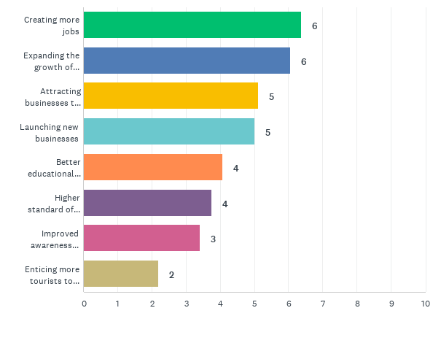
Q17: What does effective economic development mean to you? (Please rank the following by order of importance, with 1 being most important)
Answered: 309 Skipped: 5
*Scores represent a weighted average of how people answered, so the higher the score, the higher the perceived importance.

Slide 24
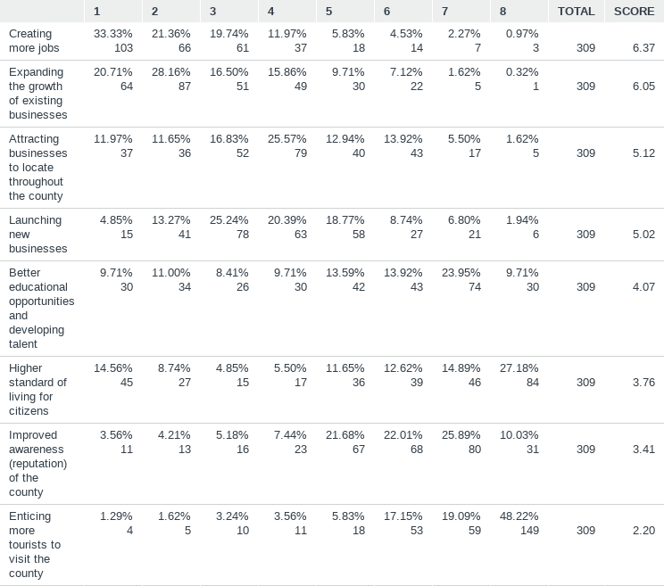
Q17: What does effective economic development mean to you? (Please rank the following by order of importance, with 1 being most important)
*Scores represent a weighted average of how people answered, so the higher the score, the higher the perceived importance

Slide 25
Q18: Please indicate how important you feel about each of these topics from not important to extremely important.

Slide 27
Q18: Please indicate how important you feel about each of these topics from not important to extremely important. *Scores represent a weighted average. Higher score=more importance
 | NOT IMPORTANT | SLIGHTLY IMPORTANT | MODERATELY IMPORTANT | VERY IMPORTANT | EXTREMELY IMPORTANT | TOTAL | WEIGHTED AVERAGE
Making vocational programs available to students | 0% 0 | 4.47% 14 | 11.50% 36 | 43.45% 136 | 40.58% 127 | 313 | 4.20
Preserving natural areas (e.g. woodlands & wetlands) | 1.28% 4 | 5.75% 18 | 18.85% 59 | 33.23% 104 | 40.89% 128 | 313 | 4.07
Protecting the Pine River | 1.60% 5 | 5.77% 18 | 18.27% 57 | 34.29% 107 | 40.06% 125 | 312 | 4.05
Redeveloping empty lots and contaminated sites | 0.64% 2 | 7.67% 24 | 18.85% 59 | 37.06% 116 | 35.78% 112 | 313 | 4.00
Improved and well‐maintained infrastructure | 0.32% 1 | 4.18% 13 | 26.37% 82 | 37.94% 118 | 31.19% 97 | 311 | 3.95

Slide 28
Q18: Continued, Slide 2
 | NOT IMPORTANT | SLIGHTLY IMPORTANT | MODERATELY IMPORTANT | VERY IMPORTANT | EXTREMELY IMPORTANT | TOTAL | WEIGHTED AVERAGE
Maintaining and improving downtowns | 0.96% 3 | 4.81% 15 | 20.83% 65 | 45.83% 143 | 27.56% 86 | 312 | 3.94
Expanded internet service | 4.81% 15 | 11.22% 35 | 23.40% 73 | 25.64% 80 | 34.94% 109 | 312 | 3.75
Preserving open spaces (e.g. farmlands & fields) | 3.85% 12 | 8.65% 27 | 30.13% 94 | 30.77% 96 | 26.60% 83 | 312 | 3.68
More local government, school and agency cooperation | 2.23% 7 | 9.24% 29 | 38.22% 120 | 29.62% 93 | 20.70% 65 | 314 | 3.57
More county‐wide recreational opportunities | 2.56% 8 | 13.74% 43 | 31.95% 100 | 30.03% 94 | 21.73% 68 | 313 | 3.55
Collaborative marketing efforts | 4.79% 15 | 16.61% 52 | 35.46% 111 | 29.71% 93 | 13.42% 42 | 313 | 3.30

Slide 29
Q18: Continued, Slide 3
 | NOT IMPORTANT | SLIGHTLY IMPORTANT | MODERATELY IMPORTANT | VERY IMPORTANT | EXTREMELY IMPORTANT | TOTAL | WEIGHTED AVERAGE
Entrepreneurship/business mentoring programs | 4.17% 13 | 18.59% 58 | 36.86% 115 | 30.77% 96 | 9.62% 30 | 312 | 3.23
Utilizing alternative energy sources | 14.70% 46 | 15.02% 47 | 25.56% 80 | 23.32% 73 | 21.41% 67 | 313 | 3.22
More public transportation options | 9.27% 29 | 22.04% 69 | 27.16% 85 | 23.00% 72 | 18.53% 58 | 313 | 3.19
Developing non‐motorized pathways | 9.62% 30 | 20.83% 65 | 30.77% 96 | 24.04% 75 | 14.74% 46 | 312 | 3.13
Expanding industrial parks | 8.39% 26 | 24.84% 77 | 43.23% 134 | 17.42% 54 | 6.13% 19 | 310 | 2.88

Slide 30
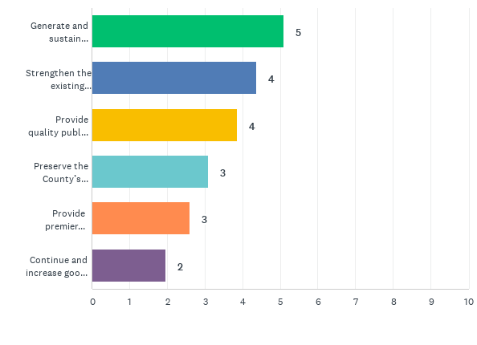
Q19: In the previous version of the Master Plan, the following goals were identified as important. Please rank the goals that you think are the most important to Gratiot County today. (Please rank the following by order of importance, with 1 being the most important)

Slide 31
Q19: In the previous version of the Master Plan, the following goals were identified as important. Please rank the goals that you think are the most important to Gratiot County today. (Please rank the following by order of importance, with 1 being the most important)
5.10
Generate and sustain economic opportunities – Retain, attract and grow quality employers and workforce
3.10
Preserve the County’s quality rural character – Keep productive farms and healthy natural features
4.38
Strengthen the existing cities, villages, and hamlets - “Placemake” Gratiot’s downtowns to ensure that they serve as quality community centers
2.60
Provide premier cultural and recreation resources - Develop Gratiot as a cultural and recreational destination that serves people of all generations
3.86
Provide quality public services and infrastructure – Carefully coordinate and plan services to ensure quality and cost effectiveness
1.96
Continue and increase good governance and inter-jurisdictional collaboration - Cultivate strong leadership and County-wide cooperation
*Scores represent a weighted average of how people answered, so the higher the score above, the higher the perceived importance

Slide 32
Priority Pillars Exercise

Slide 33
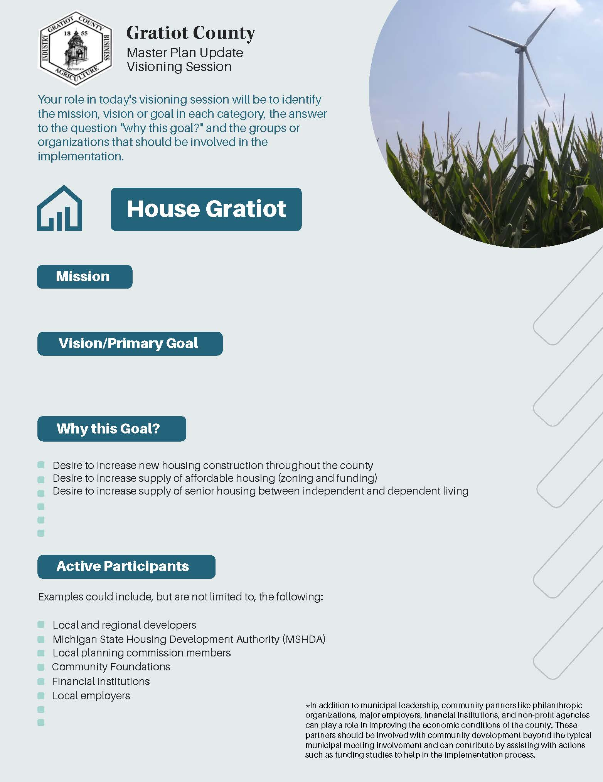
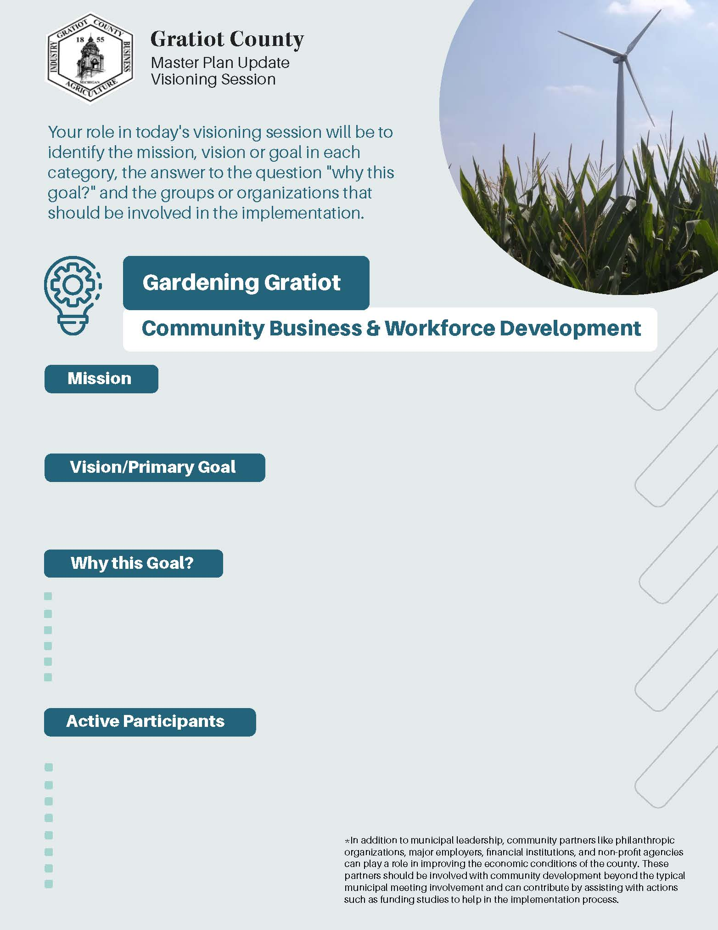
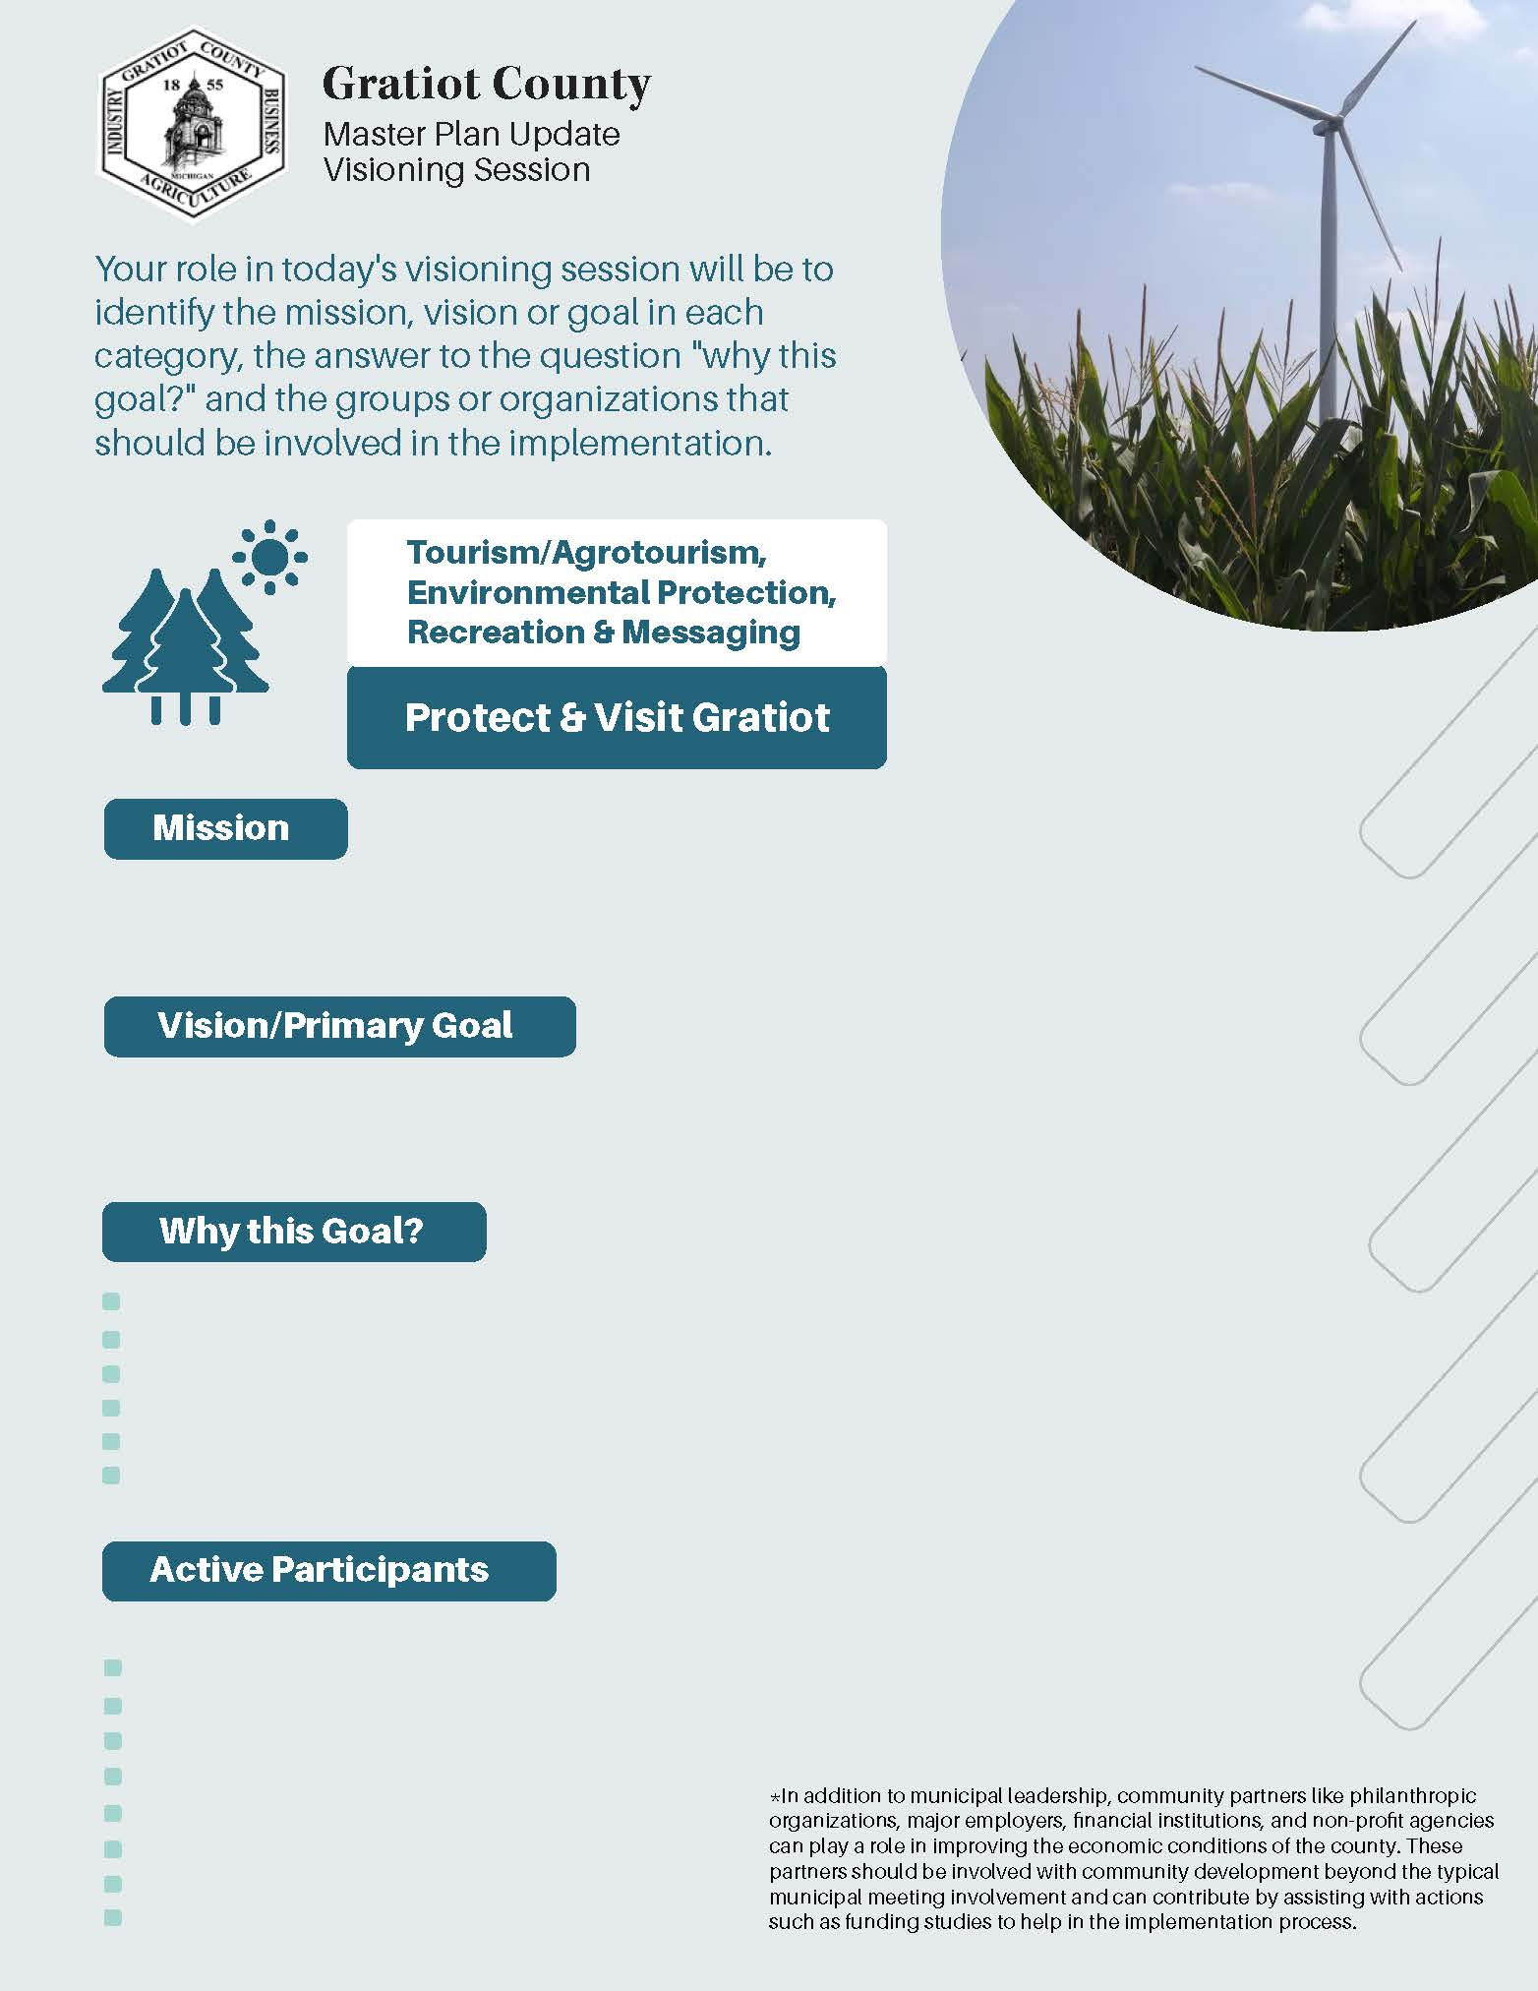

Slide 34
